Slide 1
RUC Visioning Workshop
Greg Ault

Slide 2
Time Allocation
10:45 – 12:30 Visioning Workshop
2:00 – 3:00 Vision Reporting

Slide 3
Visioning Workshop 10:45 – 12:30
Utilities
Academia
Industry
Community
ISSUES
Issue #1
Issue #2
Issue #3
Perspective
Address

Slide 4
Visioning Workshop 10:45 – 12:30
Four Distinct Perspectives
Utilities
Academia
Industry
Community
ISSUES
Issue #1
Issue #2
Issue #3

Slide 5
Visioning Workshop 10:45 – 12:30
Four Distinct Perspectives
“Role Playing” for the three major Issues.
Each table wears a role playing hat.
Each table should select a “Reporter” or spokesperson to represent the tables views and conclusions.
Consider developing the Drivers for each Perspective (ie Academics could be Research, Policy Changes and Organizational Culture)

Slide 6
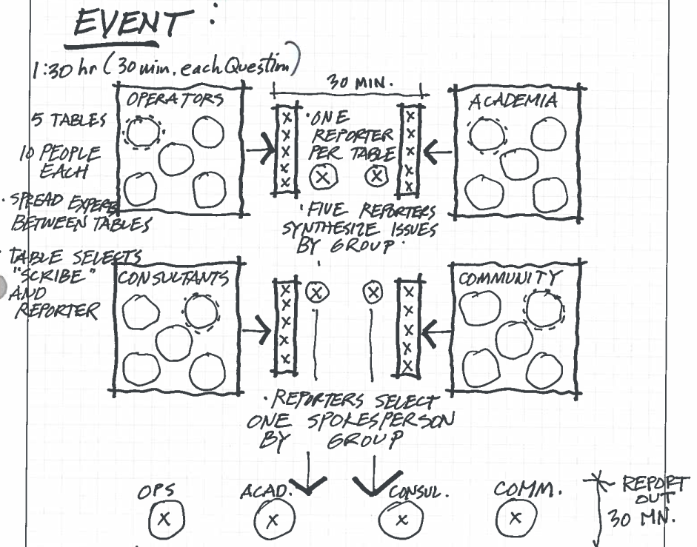
Visioning Workshop 10:45 – 12:30
Break Out Groups
Five Reporters (one from each Table) will gather over lunch to capture and synthesize the themes and conclusions of each tables' discussions.

Slide 7
Vision Reporting
One reporter will present the final Themes and Conclusions for each Group Perspective
Utilities Perspective
Academia Perspective
Consultants Perspective
Community Perspective
The results from todays workshop will form the basis for future workshops, white papers and events.

